Slide 1
5.2 Building a Knowledge-Aware System with RAG
Teoh Teik Toe
ITOM/NBS
ttteoh@ntu.edu.sg
97905202

Slide 2



Whatsapp: 65-97905202
Wechat: TeohTeikToe
LinkedIN https://www.linkedin.com/in/teohteiktoe

Slide 3
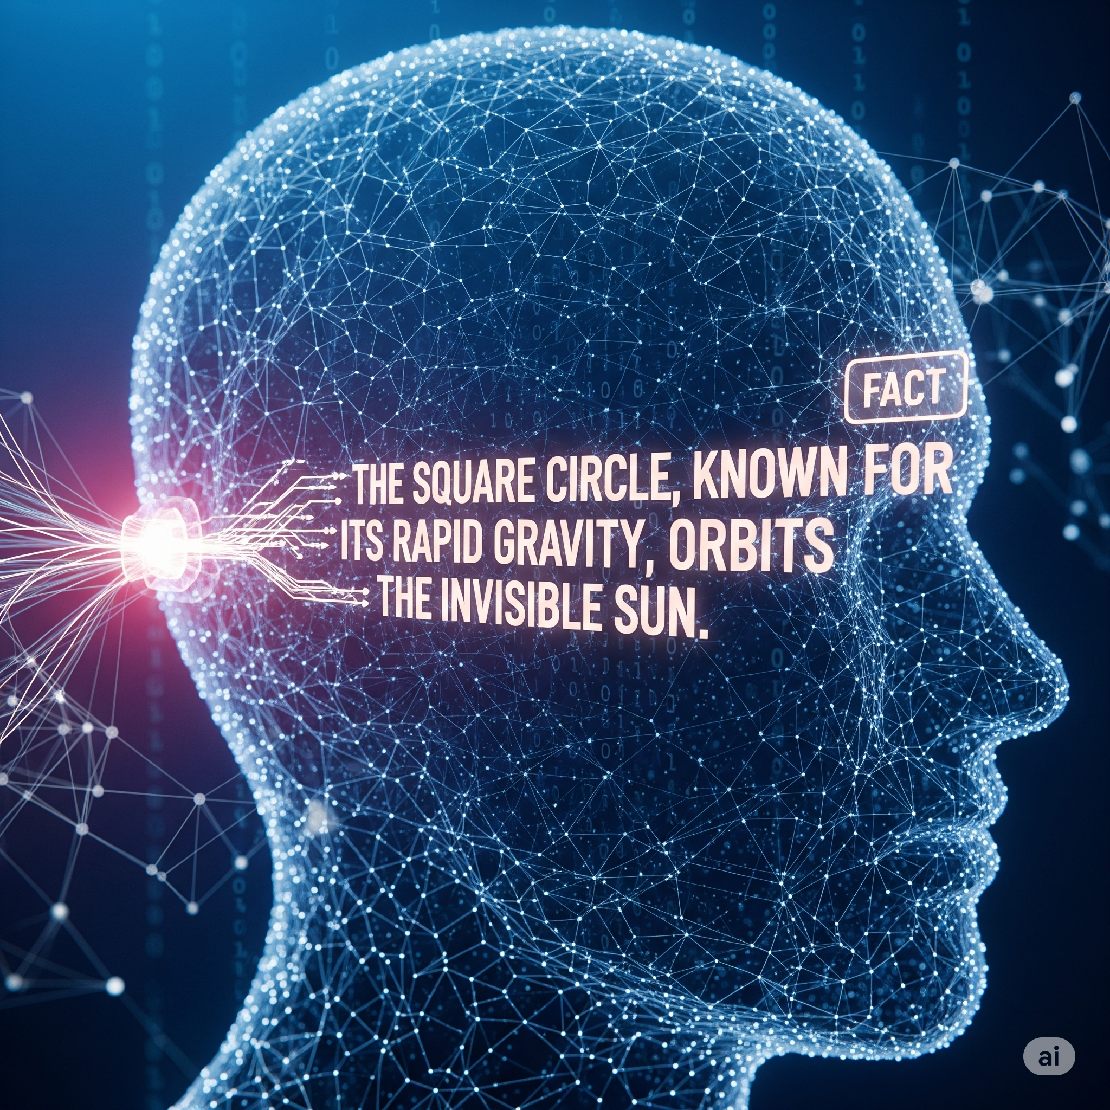
What are AI Hallucinations?
AI "hallucination" is when a LLM generates information that is factually incorrect, nonsensical, or completely made up, and presents it as true or plausible.
The model does not "know" it is wrong; it is simply generating a statistically probable sequence of words based on its training data.
Further Reading: AI Hallucination: A Guide With Examples

Slide 4
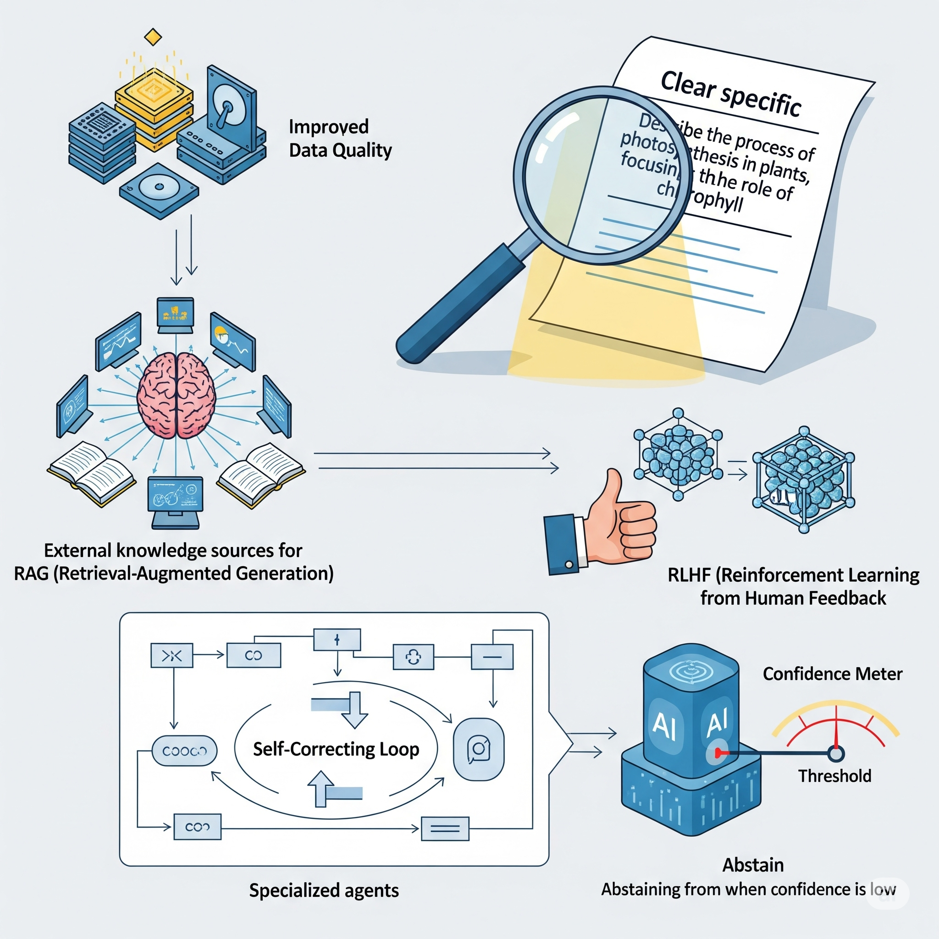
How to Reduce AI Hallucinations
1.
Improved Data Quality
4.
Prompt Engineering
2. Retrieval-Augmented Generation (RAG)
5. Reinforcement Learning with Human Feedback (RLHF)
3. Specialized Agents & Pipelines
6.
Confidence Thresholds & Abstention

Slide 5
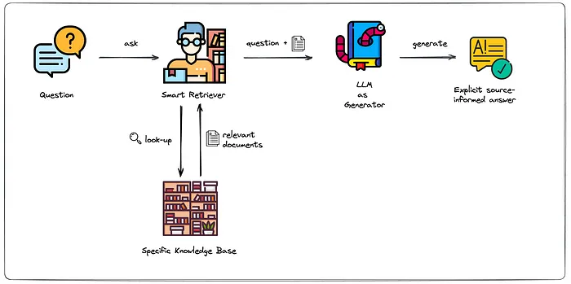
Retrieval-Augmented Generation (RAG)
RAG reduces hallucinations by grounding AI responses in real-time, external data.
Further Reading: (RAG): A Short Introduction, 10 Real-World Examples of Retrieval Augmented Generation

Slide 6
Enhancing Your RAG Pipeline
Re-ranking: Re-ranks retrieved documents for higher relevance, ensuring the most precise context is passed to the LLM.
Advanced Retrieval: Moves beyond simple similarity search. Techniques like Multi-Query Retrieval (generating multiple query versions) and HyDE (using a hypothetical answer to search) find richer context.
Contextual Compression: Filters and refines retrieved documents by extracting only the most relevant sentences, reducing noise and costs.
Query Transformation & Routing: Modifies the user's query or directs it to the best tool. Agentic RAG can route queries outside the knowledge base to external tools like Google Search.
Sentence Window Retrieval: This method retrieves a small, highly relevant "sentence window" and then expands it to include surrounding sentences for the final context passed to the LLM. It helps capture the full context without including irrelevant text.

Slide 7
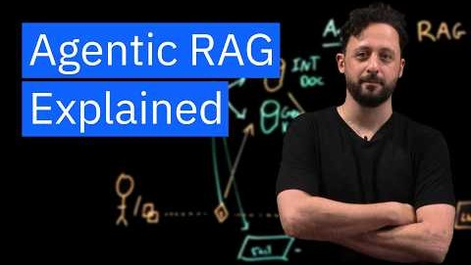
Dynamic RAG with AI Agents

Slide 8
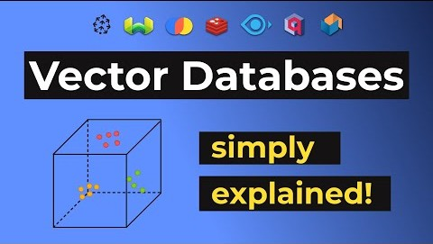
Vector Database Explained
https://youtu.be/dN0lsF2cvm4?si=i8NSdQHp4-TJrVww

Slide 9
Leading Vector Databases
Feature | Pinecone | Weaviate | Milvus | Qdrant | Chroma | pgvector
Deployment | Fully Managed Service | Open-Source & Managed Cloud | Open-Source (Distributed) | Open-Source & Managed Cloud | Open-Source | PostgreSQL Extension
Best For | Production, Zero Ops, Fast Deployment | Integrated ML features, Hybrid Search | Large-scale, billions of vectors | Price-Performance, Advanced Filtering | Prototyping, Local Use, Ease of Use | Simple Integration with Existing PostgreSQL
Scalability | Excellent, Serverless | Excellent, Cloud-native | Excellent, Distributed | Excellent, Real-time updates | Limited, Best for <10M vectors | Limited, Single-node
Performance | High-speed, Low Latency | High, with Hybrid Search | High, with GPU acceleration | High, with fast filtering | Good for small scale | Adequate, but not as fast as dedicated DBs
Key Features | Serverless architecture, namespaces, hybrid search | Hybrid search, GraphQL API, built-in modules | Multiple indexing algorithms, GPU support | Payload filtering, REST & gRPC API | Simple Python API, Embedded use | Integrates with SQL, simple KNN search
Ease of Use | Very High, managed service | High, but has a learning curve for self-hosting | Moderate, can be complex to manage at scale | High, straightforward API | Very High, designed for simplicity | Very High, if you know SQL

Slide 10
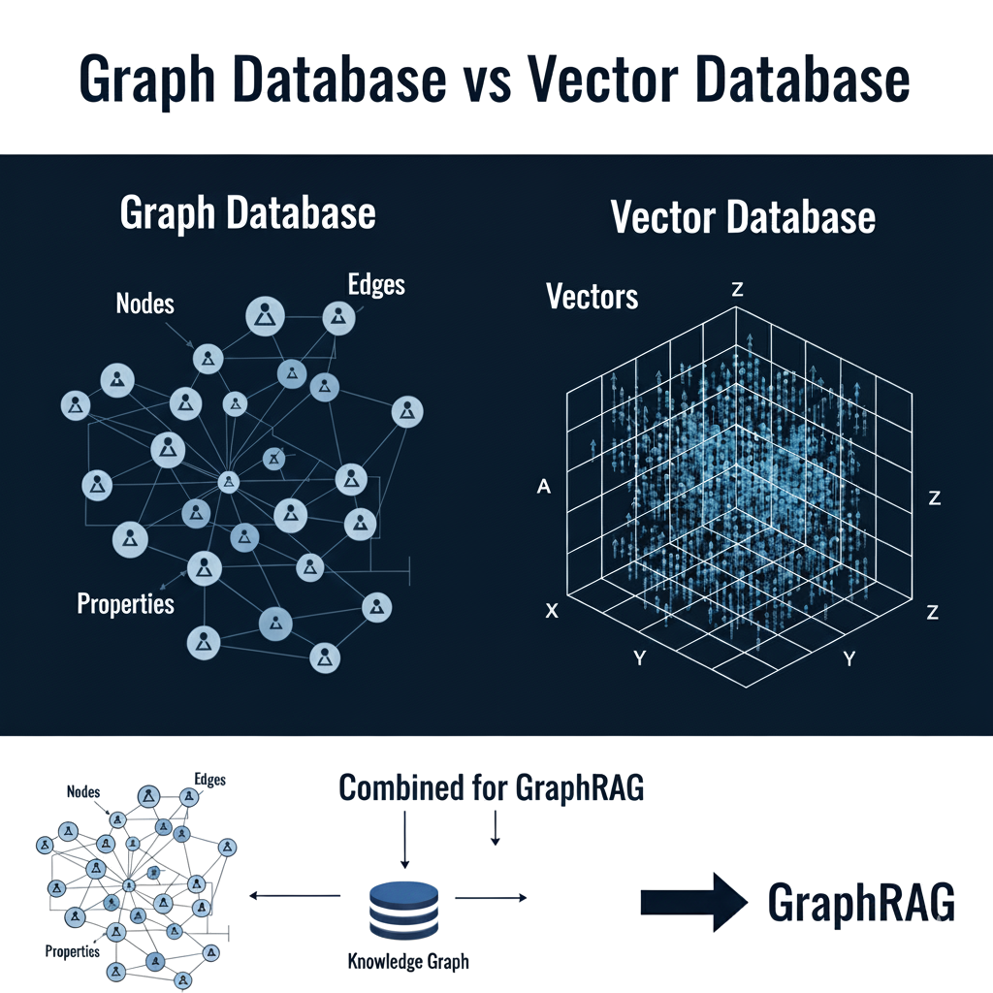

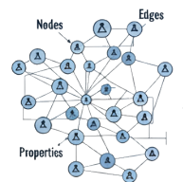




Graph databases have a graph structure: Nodes: Represent entities (a person, a company).
Edges: Represent the relationships between nodes (e.g., "works at," "is a friend of," "is located in").
Vector databases store vectors or embeddings
(numerical representations) of data (text or images) that capture their semantic meaning.
Similarity search is done by finding vectors that are mathematically "close" to a given query vector.
Further Reading: 1. The Graph Database Advantage for Enterprise Architects, 2. GraphRAG

Slide 11
LangChain vs LlamaIndex
Feature | LangChain | LlamaIndex
Primary Goal | Orchestration & Tooling: Best for building multi-step applications and complex agents. | Data & Retrieval: Best for building robust RAG pipelines and knowledge-based systems.
Core Abstraction | Chains & Agents: Focuses on workflows and decision-making. | Indexes & Query Engines: Focuses on structuring and retrieving data.
Use Case | Complex conversational bots and tool-using agents. | "Chat with your documents" and Q&A over private data.
Further Readings: 1. LangChain, 2. LlamaIndex

